Slide 1

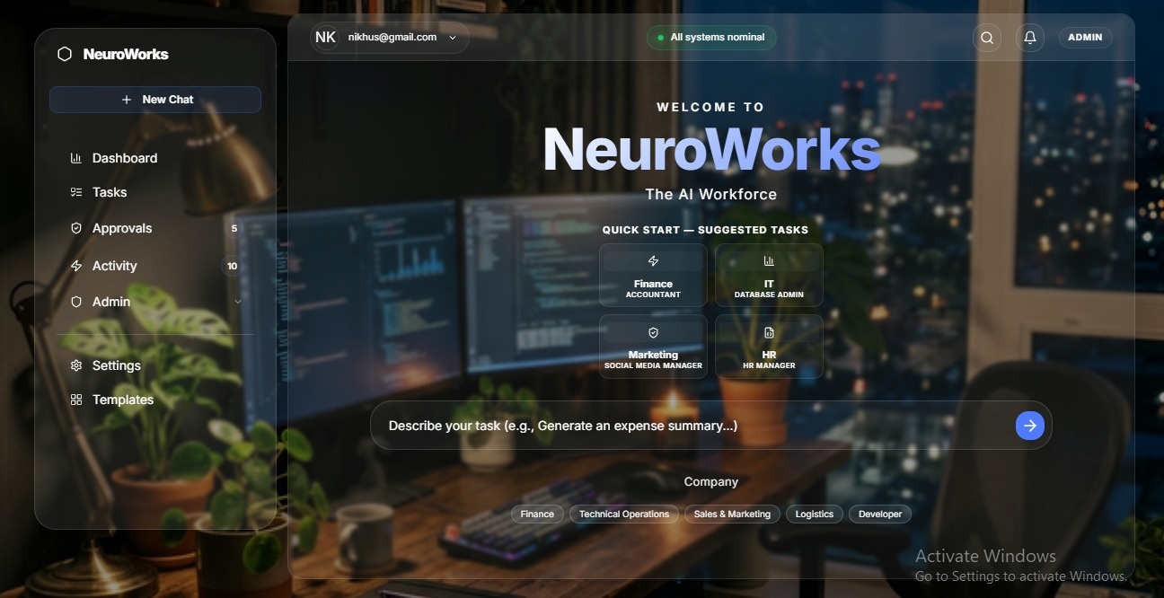
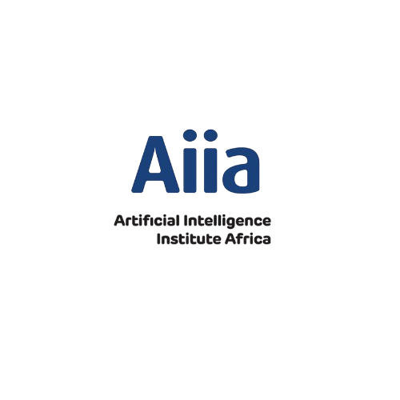
NeuroWorks
AI workforce
01
Natural Language Input or Job Description
Employees can describe tasks using natural language, making interaction simple and intuitive for everyone involved. Or upload a job description that will frame the AI’s tasks
02
Process Automation
The system efficiently translates requests into structured workflows, automating tasks across multiple systems to enhance productivity. The system converts business processes into AI workflows.
03
Comprehensive Governance
Built-in governance features ensure security and compliance, with approvals and audit trails maintaining organizational integrity throughout processes.

Slide 2

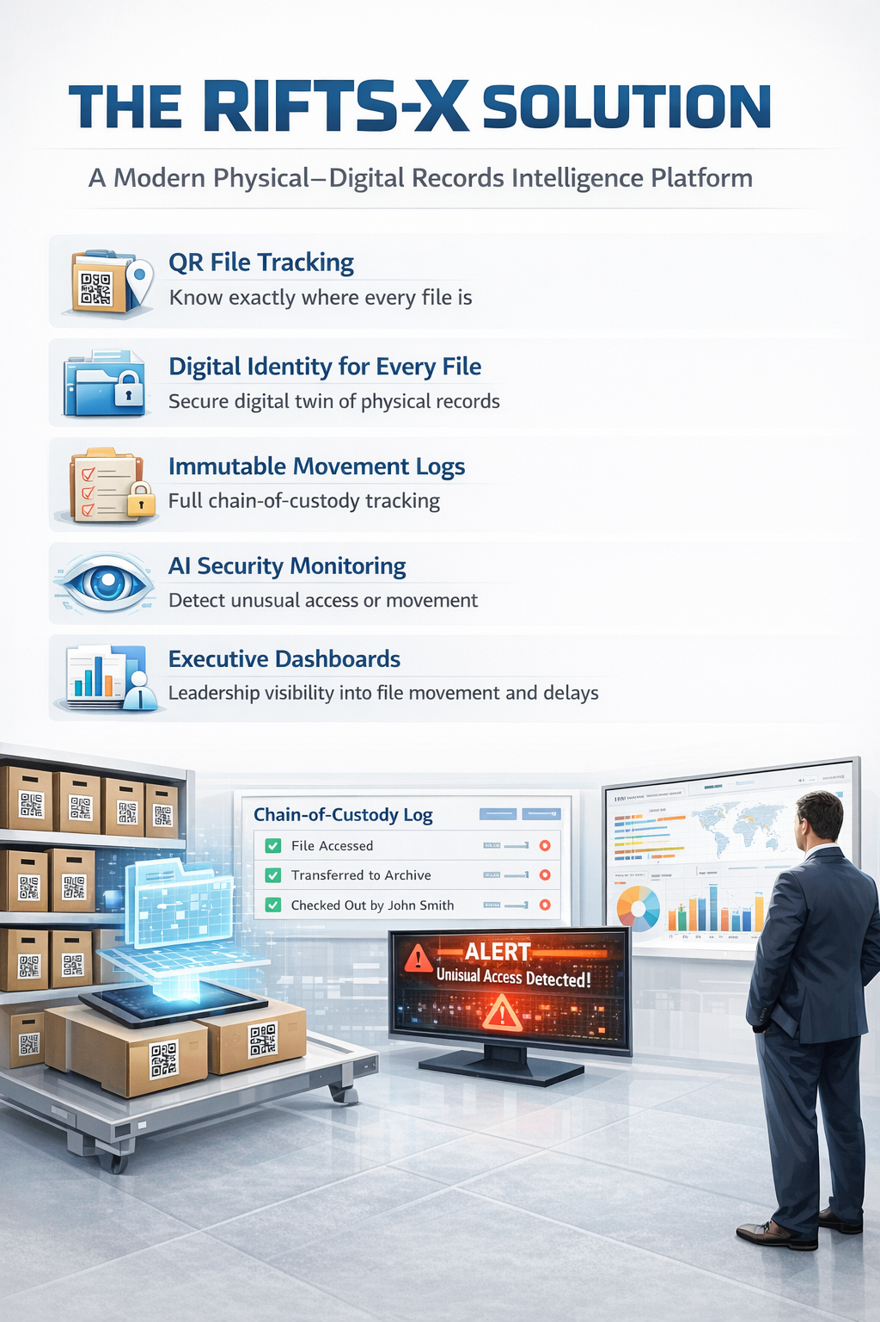
RIFTS-X - Records Intelligence & File Tracking System
Records Intelligence & File Tracking System
Transforming how government institutions manage physical and digital files
The Institutional File Problem
Government offices face daily records challenges:
• Lost or misplaced files
• No real-time visibility of file location
• Slow approvals due to manual file movement
• Paper records disconnected from digital systems
• Weak audit trails and accountability
These issues lead to delayed decisions, operational inefficiencies, and institutional risk.

